Slide 1
Probability
Measuring uncertainty

Slide 2
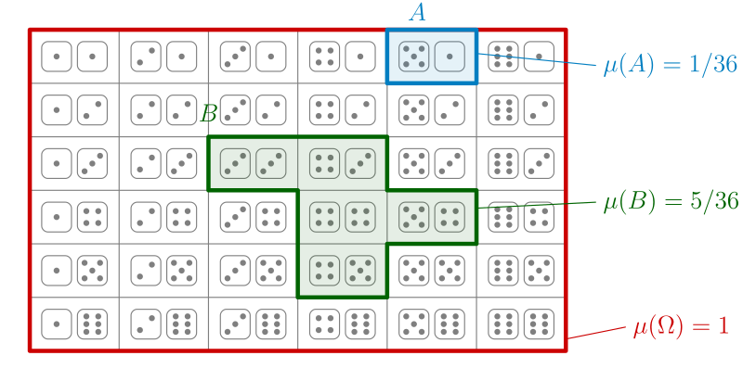
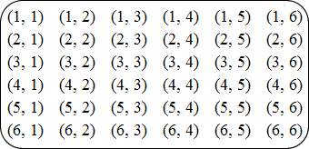
Terminology:
Sample Space: A list of all possible outcomes
Coin flip sample space: U = {Heads, Tails}
Dice roll sample space: U = {1, 2, 3, 4, 5, 6}

Slide 3
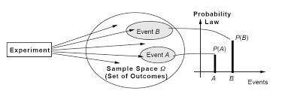
Terminology
Experiment: A well-defined process that leads to a single, unpredictable result.
Example: Rolling a die
Outcome: A specific result that can happen in an experiment.
Example: Landing on 4
Event: A collection of one or more outcomes from an experiment; the group of outcomes you’re interested in
Example: Landing on an even number
Sample Space: The set of all possible outcomes of an experiment
Example: Landing on 1, 2, 3, 4, 5, or 6

Slide 4
Sample Space and Events

Slide 5
From Whence? Simple and/or Uniform Probability
Probability based on the nature of the experiment where all outcomes are equally likely.
Divide 1 by the number of possible outcomes.
Probability of rolling a 5 on a 6 sided dice? ⅙ = 0.16666667 = 17%ish
Probability of landing on heads? Two sides, so ½ = 0.5 = 50%

Slide 6
Probability Basics
Ranges between 0 and 1
0 = 0% = Impossibility
0.33 = 33% = Happens ⅓ of the time, doesn’t happen ⅔’s of the time
0.5 = 50% = Happens ½ of the time, doesn’t happen the other ½ of the time
0.75 = 75% = Happens ¾ of the time, doesn’t happen ¼ of the time
1 = 100% = Certainty
Probability can be described as a decimal, percentage, or fraction.

Slide 7
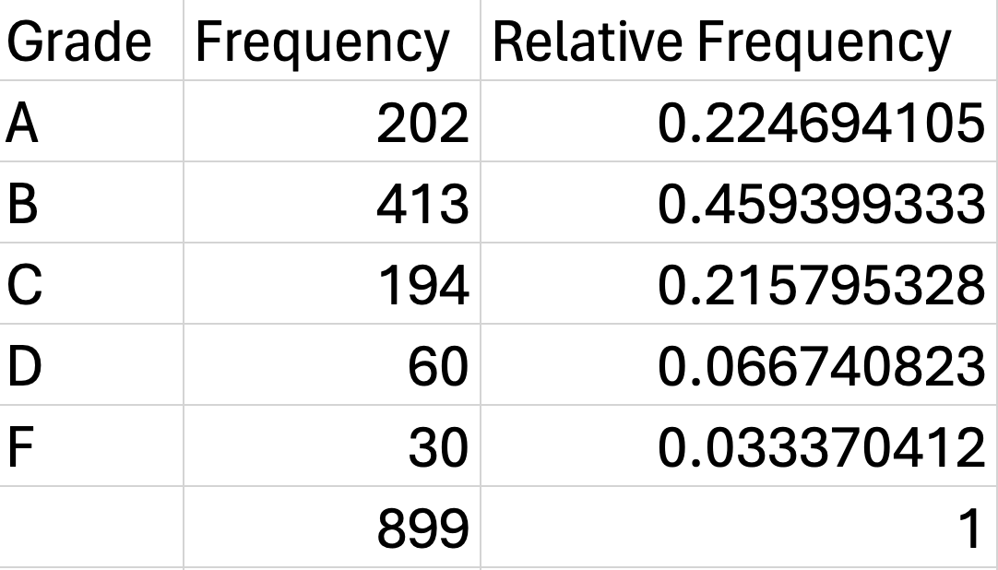
From Whence? Empirical Probability
Probability as relative frequency
Obtained from past observations
P(A) = # of times A / # of times total
The probability that a given student will get an A, based on past student grades, is 202/899 = 0.22 = 22%

Slide 8
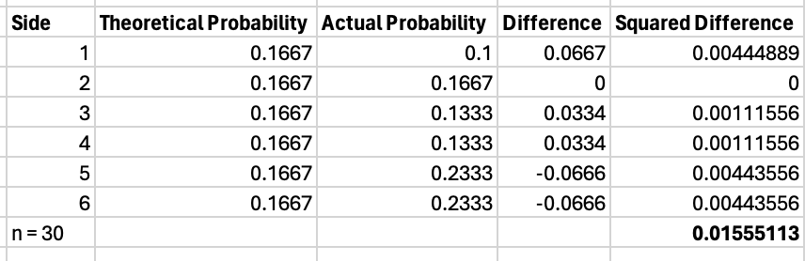
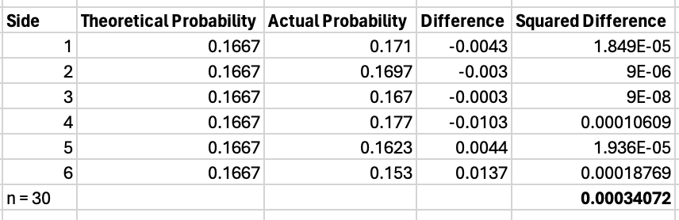
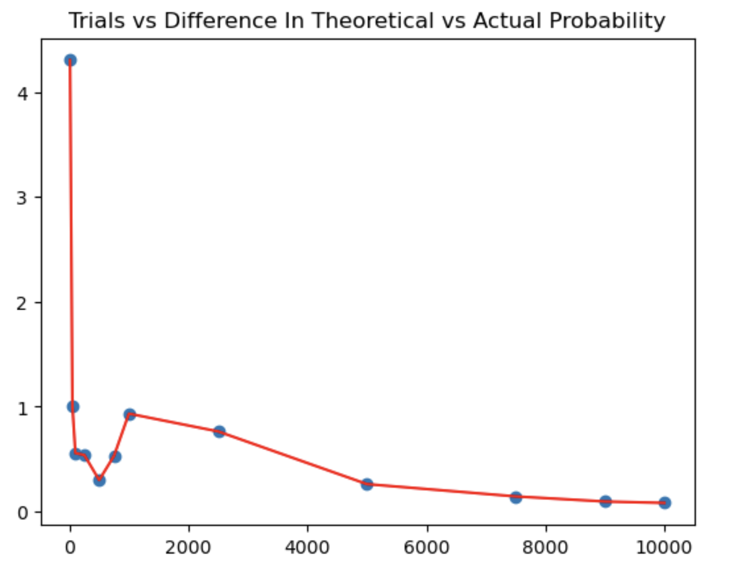
Accuracy and Asymptotics
Probability allows us to calculate a best guess, but outcomes are still uncertain
As the number of trials tends towards infinity, the difference between the actual outcomes and the theoretical outcomes tends towards zero

Slide 9
Notation
P(A) is the marginal probability that an experiment will produce outcome A
P(Heads) = 1/2, P(6) = 1/6, P(Queen) = 4/52
P(A or B) is the probability that A will occur, B will occur, or both A and B will occur
P(A and B) is the probability that A and B will both occur
P(A|B) is the conditional probability that A will occur, given that B has occurred
P(A’) is the probability of the complement* to A

Slide 10
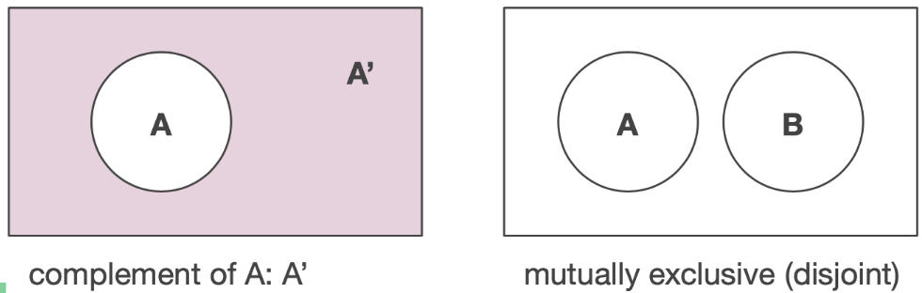
Mutually Exclusive & Complementary Events
Mutually exclusive events cannot occur together
If A and B are complements, P(A or B) = 1 and P(A and B) = 0
P(Rain OR Not-rain) = 1
P(Rain AND Not-rain) = 0
Complements are events that are mutually exclusive and collectively exhaustive:
P(A’) = 1 - P(A)
P(Not-rain) = 1 - P(Rain)

Slide 11
Independent and Dependent Events
Independent events: Events that do not change the probability of one another
Example: Coin flips - Getting heads one time does not tell us anything about what will happen next time we flip the coin (assuming a fair coin)
Dependent events: The probability of an event DOES change with the occurrence or absence of another event
Example: Selecting cards from a deck (without replacement)
Probability of getting a queen = 4/52 = 7.7%
Probability of getting another queen after removing the first one: 3/51 = 5.9%
P(A third queen) = 2/50 = 4%
Note these are isolated draws / I’m not asking the probability you’ll draw two or three cards in a row and they’ll both be queens. (That would be P(Q1 and Q2)) = P(Q1) * P(Q2|Q1) = 0.077 * 0.059 = 0.0043, or 0.43%)

Slide 12
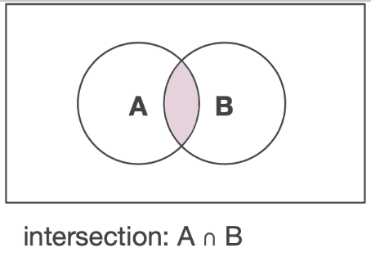
The Multiplication Rule / Formula - And Scenarios
Used for “AND” scenarios = P(X and Y)
Independent events: P(X and Y) = P(X) * P(Y)
P(Roll a six AND draw a queen) = P(6) * P(Q) = 1/6 * 4/52 = 0.16666 * 0.07692 = 0.0128, or 1.28%
Dependent events: P(X and Y) = P(Y) * P(X|Y)
P(Drawing two cards and both are hearts = P(Heart 1) * P(Heart 2|Heart 1)
P(Heart 1) = 13/52 = 0.25 (First draw)
P(Heart 2| Heart 1) = 12/51 = 0.235 (Second draw)
P(Heart 1 and Heart 2) = 0.25 * 0.235 = .05875
Or 5.87%

Slide 13
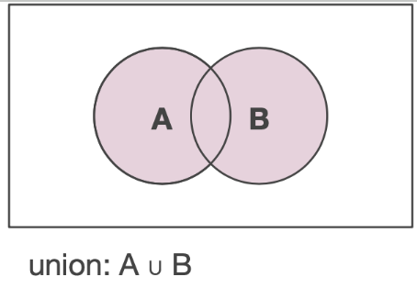
The Addition Rule / Formula - Or Scenarios
Used for “OR” scenarios = P(X, Y, or Both)
Addition rule for non-mutually exclusive events:
Does one prevent the other? Cause the other?
P(X or Y) = P(X) + P(Y) - P(X AND Y)
P(“It rains” OR “it’s Tuesday”) = 105/365 + 1/7 - (105/365 * 1/7)
.287 + .143 - .041 = .389
38.9%

Slide 14
The Conditional Probability Formula
(A|B) = The probability of A, given the occurrence of B
P(A|B) = P(A and B) / P(B)
P(B|A) = P(A and B) / P(A)
Assume 100 people buy new cars. 40 bought warranties, 30 bought red cars, and 20 purchased both.
What is the probability that someone who purchased a warranty also bought a red car?
P(warranty)=0.4, P(red car)=0.3, P(warranty and red car) = 0.2
0.2 / 0.4 = 0.5
=50%

Slide 15
Bayes

Slide 16
Probability vs Odds
P(A) is the probability of outcome A
P(A) / 1 - P(A) = Odds
Odds of rolling a 6 = 1/6 divided by 1 - 1/6 (6/6 - ⅙ = 5/6 = 0.83)
0.17 / 0.83 = .2 or 20%
1 - P(Heads) = P(Tails)
1 - P(6) = P(1,2,3,4,5)

Slide 17
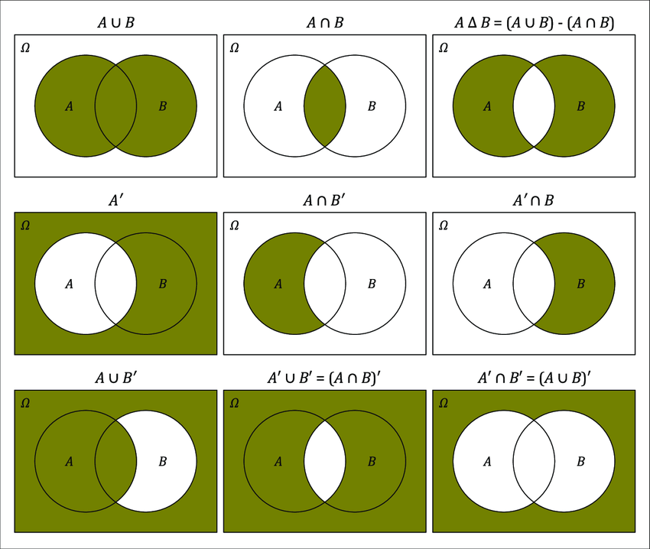
Set Theory and Probability with Venn Diagrams

Slide 18
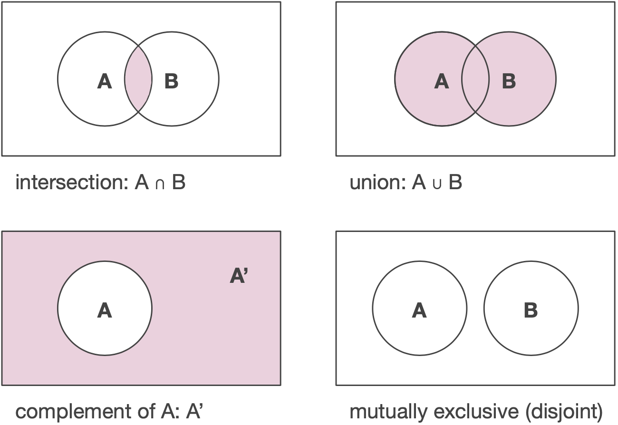

Slide 19
Probability Using Distributions

Slide 20
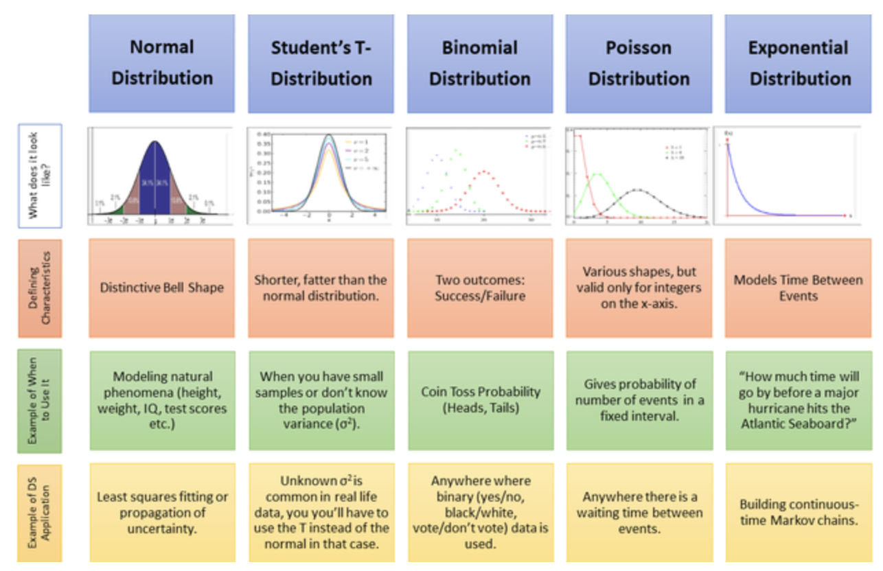

Slide 21
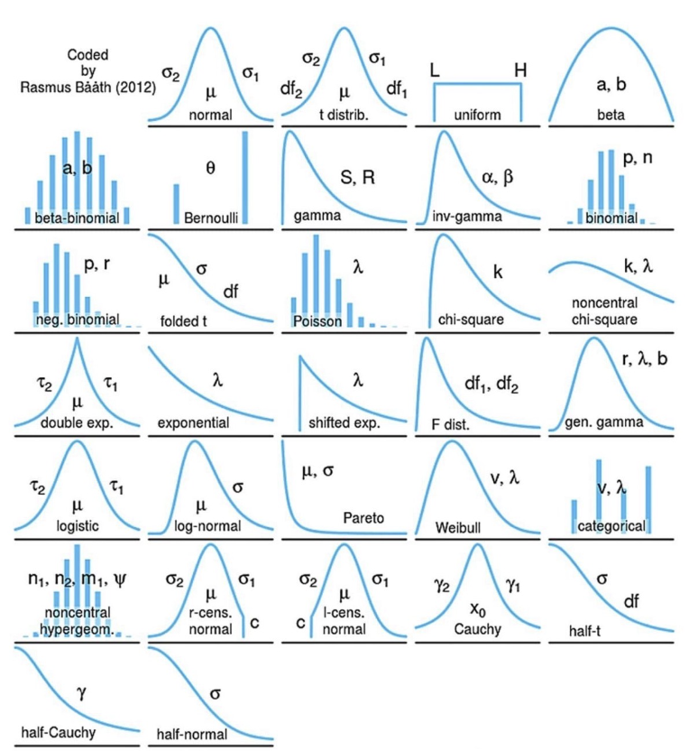
Probability Distributions

Slide 22
Types of Probability Distributions
Continuous
Discrete

Slide 23
Continuous Probability Distributions
The Normal and Standardized Normal Distributions

Slide 24
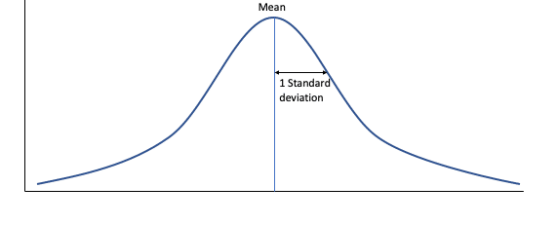
The Normal Distribution
Characteristics:
Centered on the mean value of the data
Mean = Median = Mode = Peak of Curve
Symmetrical - 50% of the data are above the mean and 50% are below the mean
Width determined by the standard deviation of the data

Slide 25
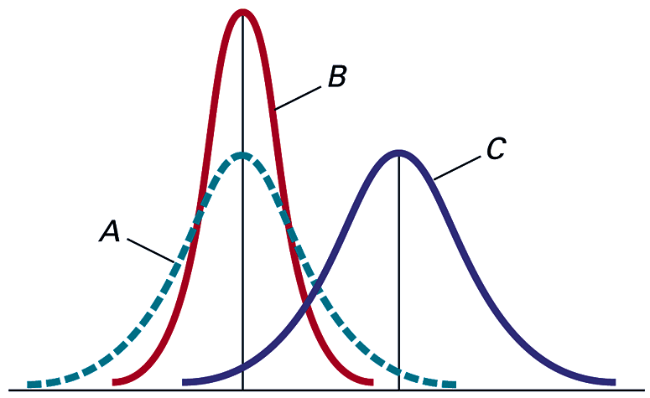
The Normal Distribution
Distributions A and B have the same mean value, but A has a larger standard deviation than B
Distributions A and C have the same standard deviation, but C has a larger mean than A

Slide 26
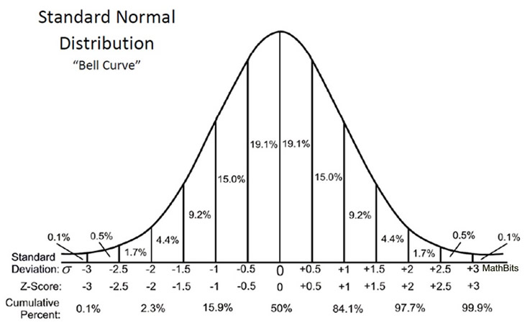
The Standardized Normal Distribution
The standardized normal distribution is a special case of the normal distribution
Mean = 0
Standard Deviation = 1
Any normally distributed data can be converted to the standardized normal distribution using the Z formula
Z = (X - Mean) / Standard Deviation
Z = # of standard deviations away from the mean
Z is negative if below the mean and positive if above

Slide 27
Z
Z = (X - Mean) / Standard Deviation
If we have a series with a mean of 50 and a standard deviation of 15, what is the Z value for the number 18
Z = (18 - 50) / 15 = -1.77
Interpretation: 18 is 1.77 standard deviations below the mean

Slide 28
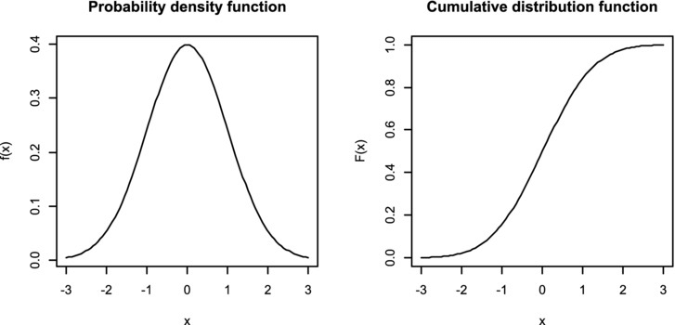
PDF vs CDF
Probability Density Function: provides the likelihood of a random variable taking a given value or range of values
Cumulative Density Function: shows the probability that random variable will take a value less than or equal to a given value
(Area under PDF always sums to 1)

Slide 29
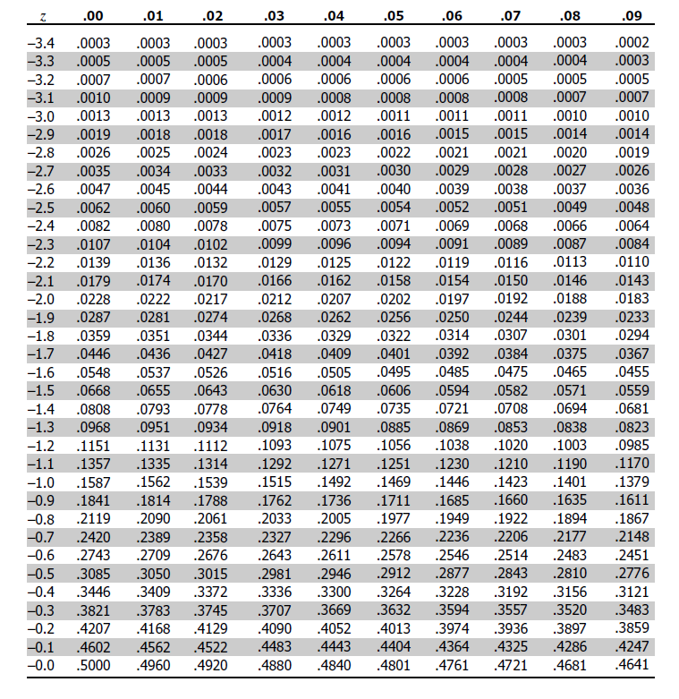
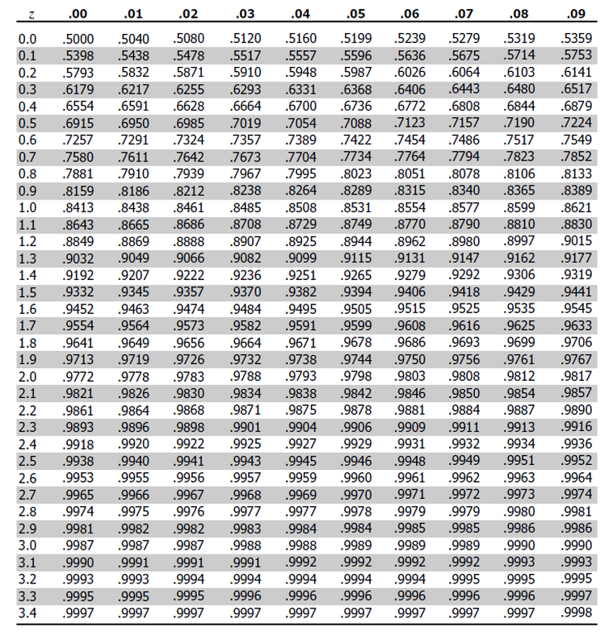
Why convert to the standardized normal distribution?
So that we can use pre-calculated probabilities from a Z table / statistics software!

Slide 30
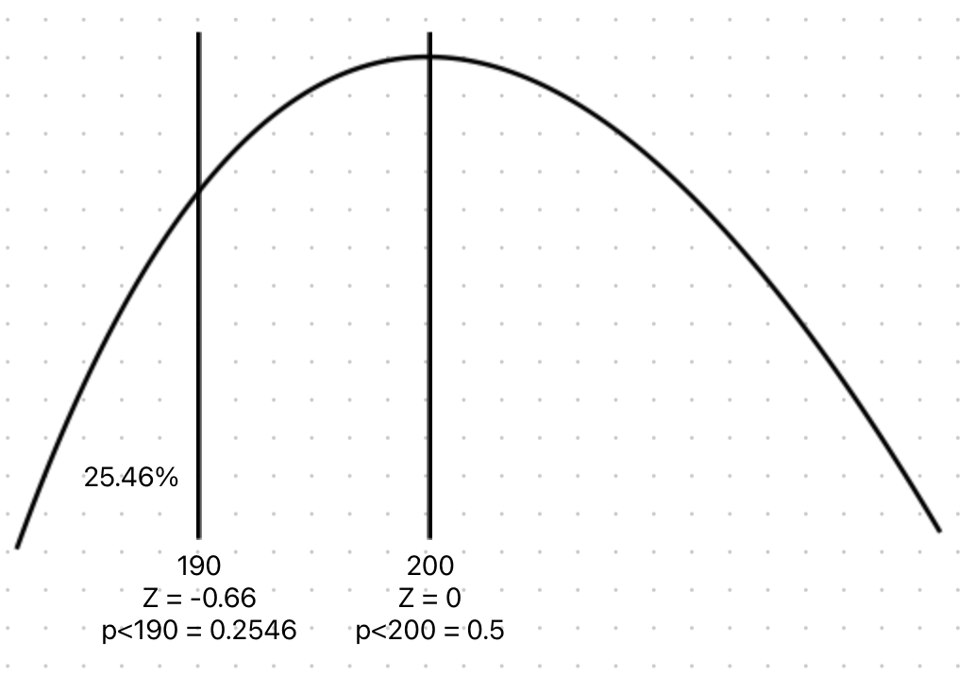
Probabilities Using Z - p(x<X)
Given normally distributed monthly sales data with a mean of 200 and a standard deviation of 15, what is the probability of a selling less than 190 units on any given month?
Z = (190-200)/15 = –0.66
p(x<190) = .2546

Slide 31
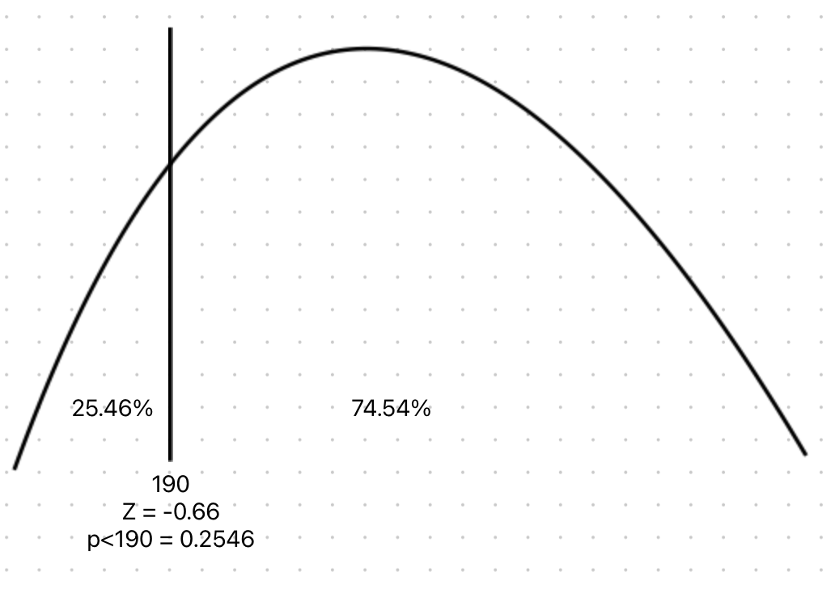
Probabilities Using Z - p(x>X)
Given normally distributed monthly sales data with a mean of 200 and a standard deviation of 15, what is the probability of a selling more than 190 units on any given month?
Z = (190-200)/15 = –0.66
p(x<190) = .2546
p(x>190) = 1 - .2546 = .7454 = 74.54%

Slide 32
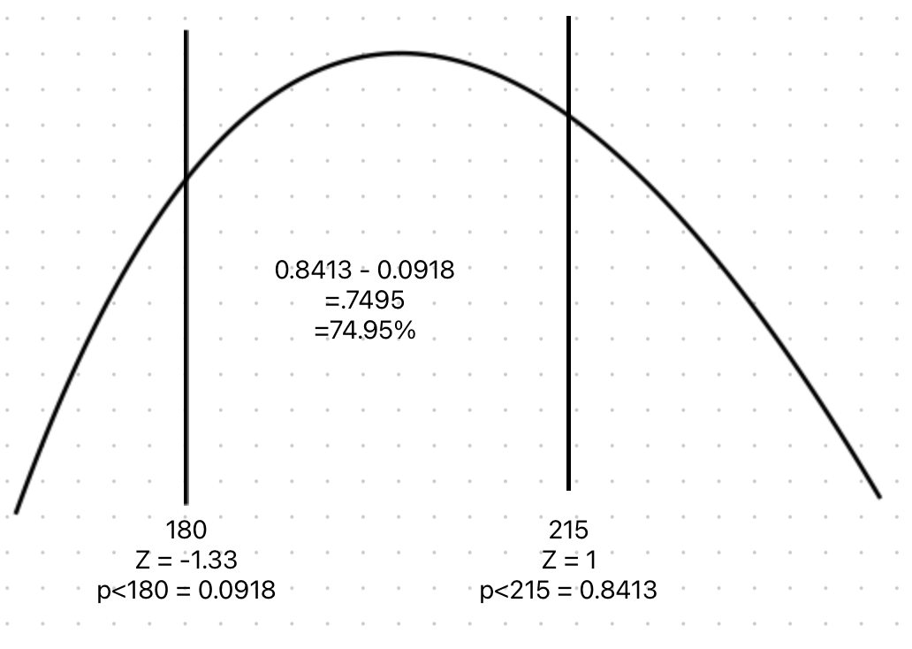
Probabilities Using Z - p(XL<x<XH)
Given normally distributed monthly sales data with a mean of 200 and a standard deviation of 15, what is the probability of a selling between 180 and 215?
Z = (180-200)/15 = –1.33
p(<180) = 0.0918
Z = (215-200)/15 = 1
p(<215) = 0.8413
= 74.95%

Slide 33
Normal Distribution in Excel
=standardize(x, mean, stdev) to find Z
=norm.dist(x, mean, stdev, TRUE) for <=
= 1 - norm.dist(x, mean, stdev, TRUE) for >

Slide 34
Discrete Probability Distributions
Binomial and Poisson

Slide 35
Factorials!
The factorial of a number is the product of that number multiplied by all of the positive integers below it
n! = n * (n-1) * (n-2)...3 * 2 * 1
5! = 5 x 4 x 3 x 2 x 1 = 120
1! = 1
0! = 1

Slide 36
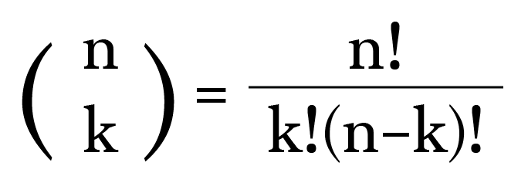
Combinations
How many groups of k size can be made from a set of n items?
How many ways can 5 cards be drawn from a deck of 52?
52! / 5!*47!...
Use a calculator / computer!
=2598960

Slide 37
Binomial Probability
Use to calculate probability of getting a fixed number of successful outcomes in a fixed number of independent trials where each trial has only two possible outcomes
Assumes:
A fixed number of trials
Outcomes are binary
Trials are identical (p doesn’t vary)
Trials are independent
Could be used to estimate the probabilities of:
A certain number of customers purchasing a car
A certain number of defaults in a portfolio of loans
A certain number of defective products in a production process
A certain number of successful treatments of sick patients

Slide 38
Binomial Probability Formula
n
!
P(X=x |n,π)
=
x
n
−
x
π
(1-π)
x!
(
−
)
n
x
!
n = number of events
x = number of successes
pi = probability of success

Slide 39
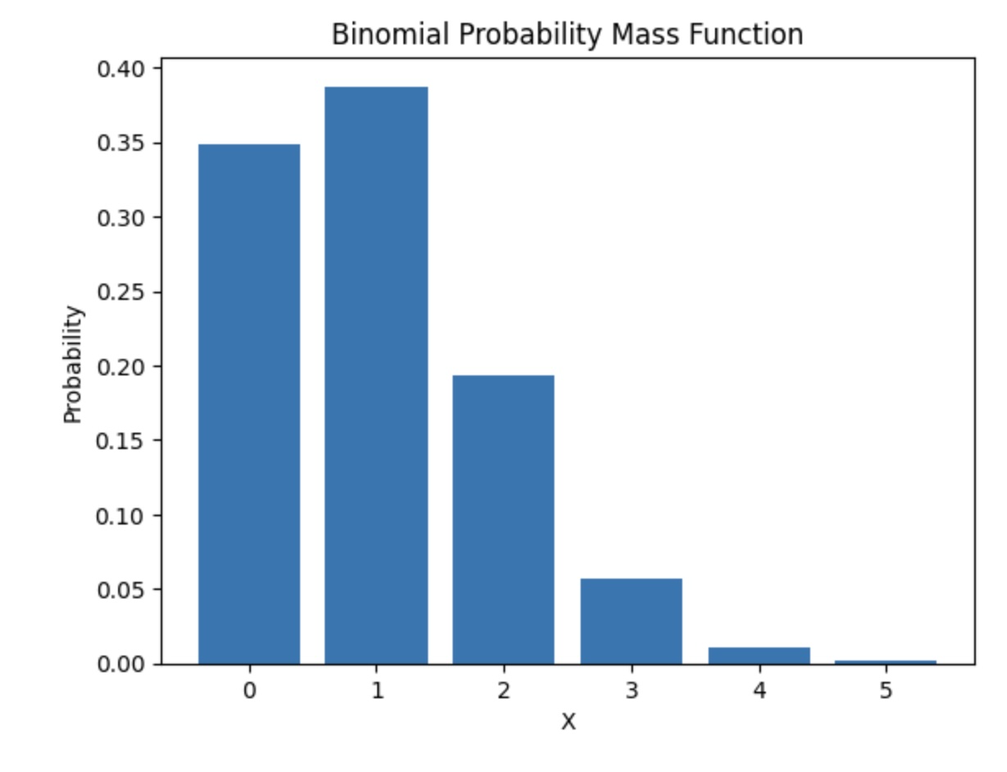

Slide 40
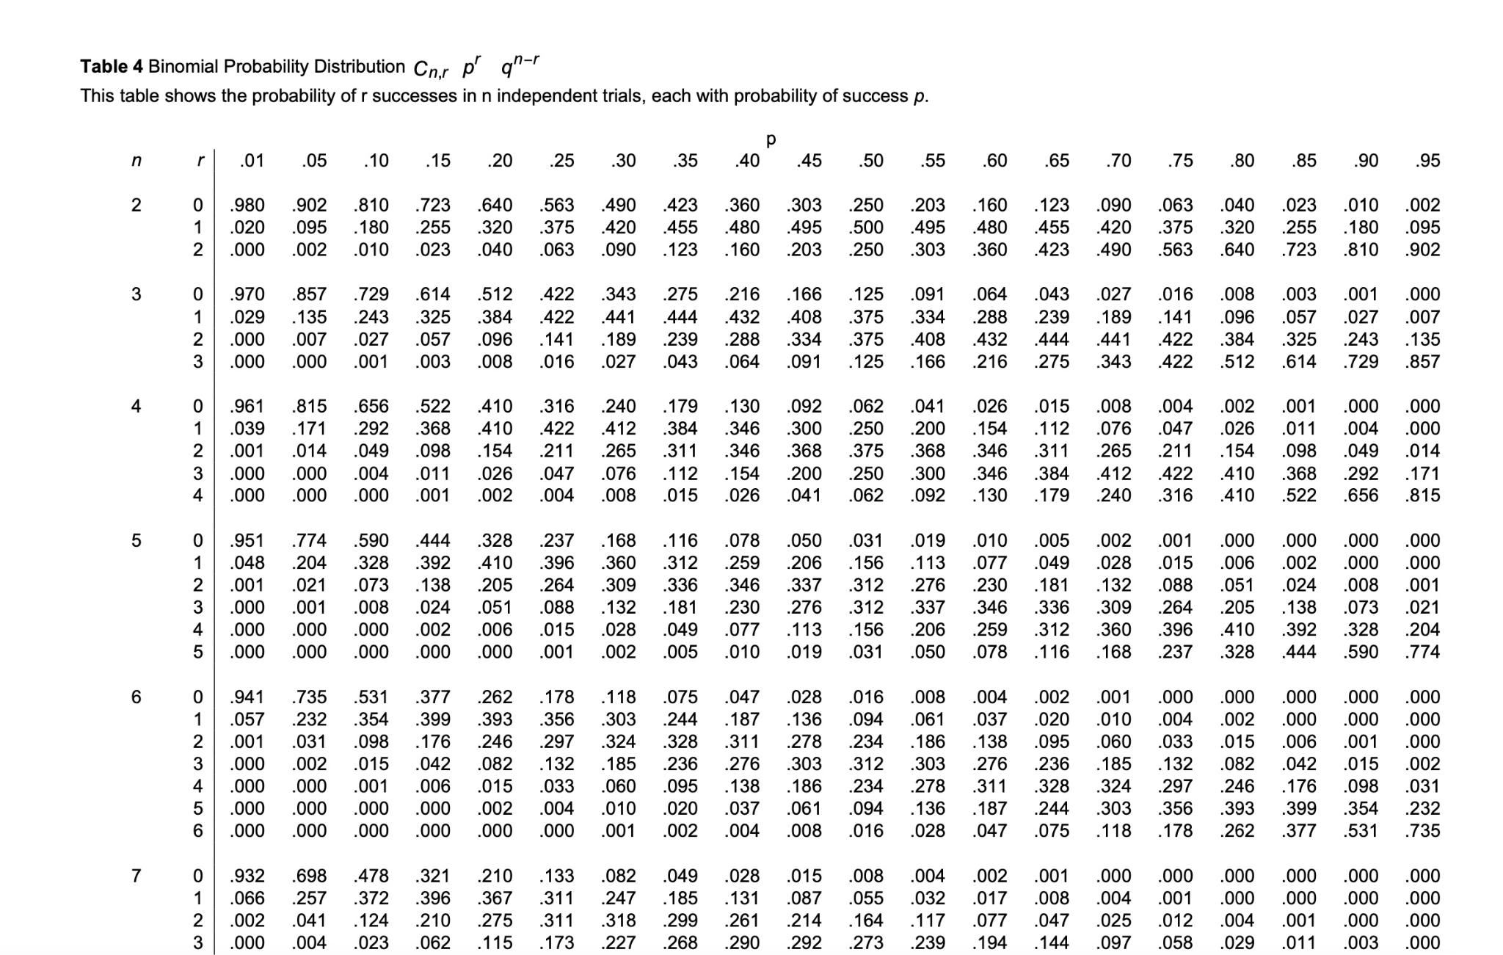

Slide 41
Binomial Probability
n
!
P(X=x |n,π)
=
x
n
−
x
π
(1-π)
x!
(
−
)
n
x
!
What is the probability of getting two heads in a series of five coin flips?
n =5, x = 2, pi = 0.5

Slide 42
Binomial in Excel
=binom.dist(x, # of trials, probability of success, False) for specific values
=binom.dist(x, # of trials, probability of success,True) for <=
=1 - binom.dist(x, # of trials, probability of success, True) for >

Slide 43
What is the probability of getting two heads in a series of 5 coin flips?
n =5, x = 2, pi = 0.5
= 0.312
p(x<2)?
p(0) + p(1)
0.031 + 0.156 = 0.187 = 18.7%
p(x>=2)?
1 - 0.187 = .813 = 81.3%

Slide 44
Binomial Probability Problems
Given a 10% chance of default and 6 loans, what is the probability of
5 defaults (=): Calculate p(5)
Less than 5 defaults (<):
Calculate p(0) + p(1) + p(2) + p(3) + p(4)
5 of less defaults (<=):
Calculate p(0) + p(1) + p(2) + p(3) + p(4) + p(5)
More than 5 defaults (>):
Calculate 1 - [p(0) + p(1) + p(2) + p(3) + p(4) + p(5)]
5 or more defaults (>=):
Calculate 1 - [p(0) + p(1) + p(2) + p(3) + p(4)]

Slide 45
Poisson Probability
Could be used for estimating the probabilities of:
A certain number of customers entering a store per hour
A certain number of phone calls received by a call center
A certain number of employees calling in sick
Use to calculate the probability of a given number of events occurring in a given interval of time or space
Assumes:
Events are independent
Average rate is constant
No simultaneous events
Mean = Variance

Slide 46
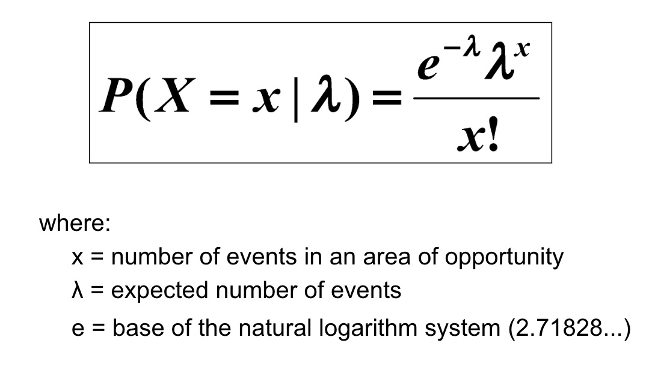
Poisson Probability Formula

Slide 47
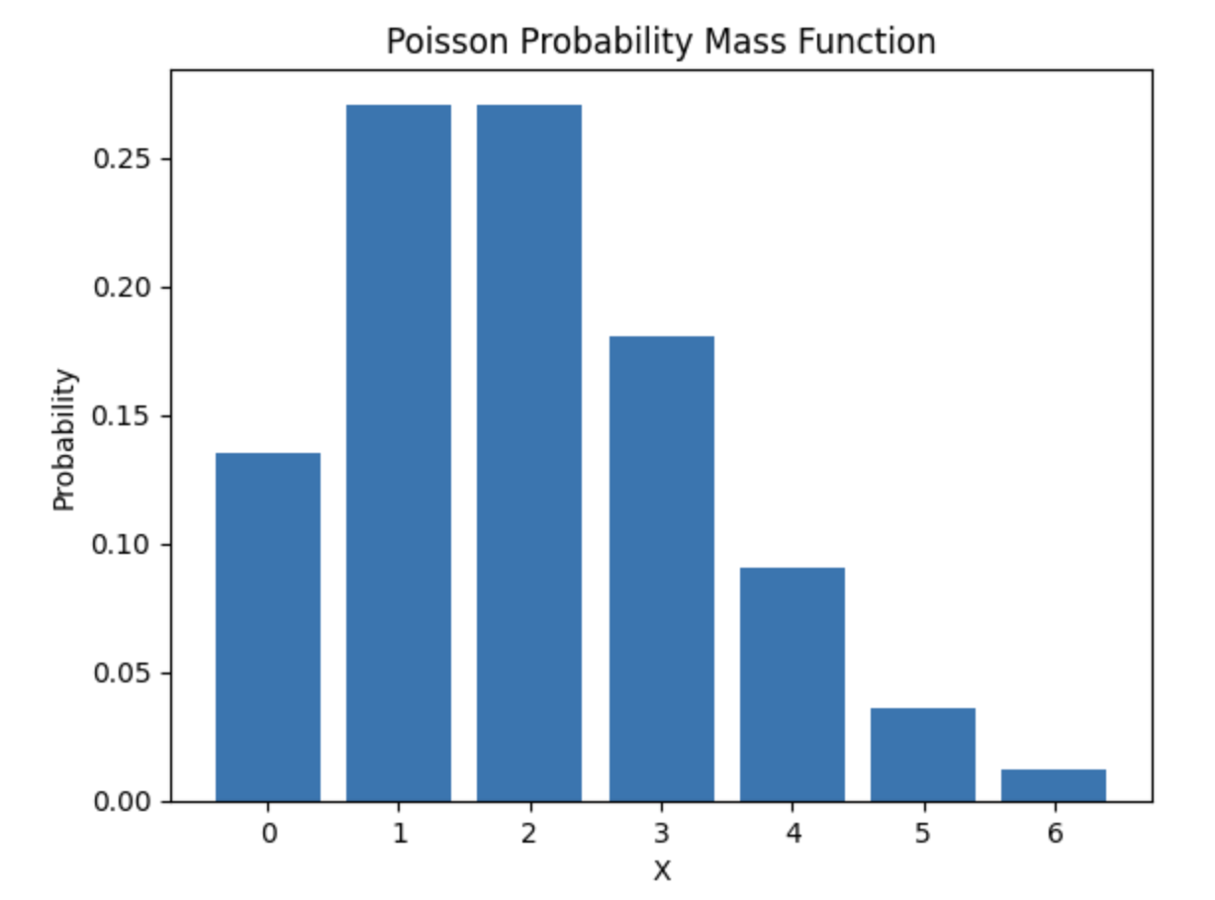

Slide 48
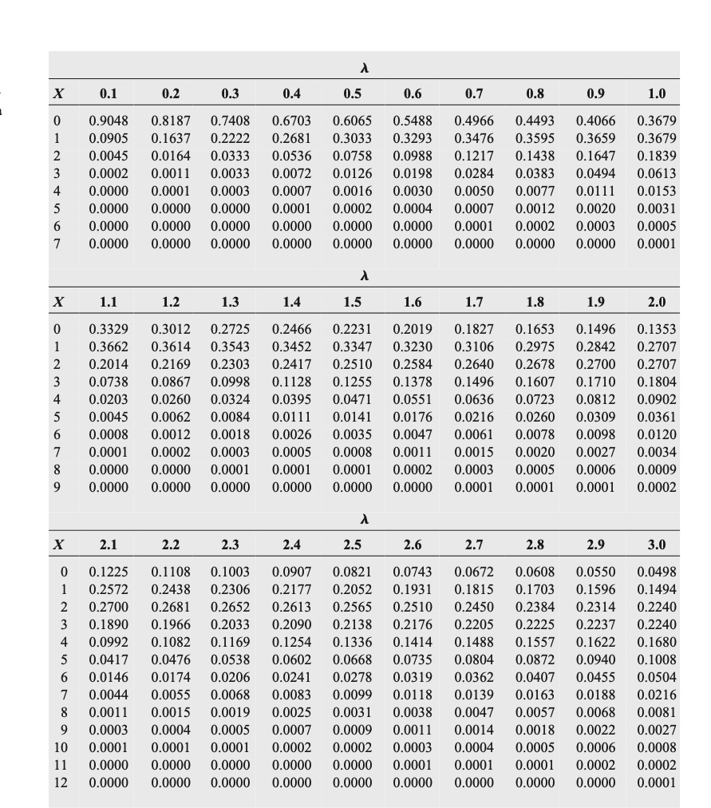
Poisson Distribution Table
Non-Cumulative
(Many pages omitted)
Example:
Average number of calls in an hour is 3
What is p(x=4)?
Find lambda = 3 and x = 4
.1680 = 16.8%
What is p(x<4)?
p(0) + p(1) + p(2) + p(3) = .0498 + .1494 + .2240 + .2240
=.6472 = 64.72%
What is p(x>=4)
= 1 - 0.6472 = .3528 or 35.28%

Slide 49
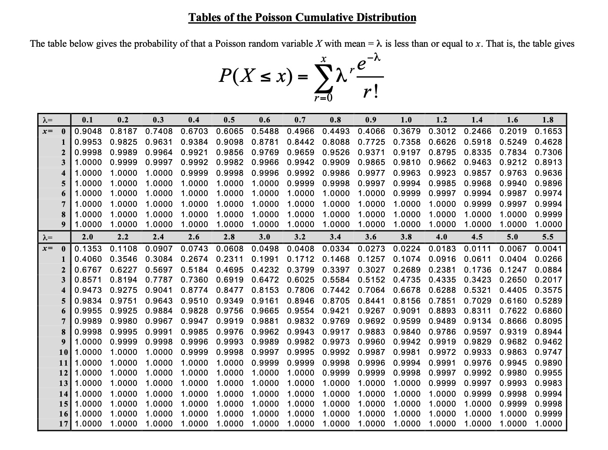
Poisson Distribution Table
Cumulative
(Many pages omitted)
Example:
Average number of calls per hour is 3
What is p(x<4)?
Find lambda = 3 and x = 3
0.6472 or 64.72%
What is p(x>4)
1-.6472 = .3528 = 35.28%

Slide 50
Poisson Probability
What is the probability of getting 10 calls in an hour if the average hourly call rate is 5?

Slide 51
Poisson Probability Problems
Given an average of 10 customers per hour, what is the probability you’ll have
5 customers (=): Calculate p(5)
Less than 5 customers (<):
Calculate p(0) + p(1) + p(2) + p(3) + p(4)
5 of less customers (<=):
Calculate p(0) + p(1) + p(2) + p(3) + p(4) + p(5)
More than 5 customers (>):
Calculate 1 - [p(0) + p(1) + p(2) + p(3) + p(4) + p(5)]
5 of more customers (>=):
Calculate 1 - [p(0) + p(1) + p(2) + p(3) + p(4)]

Slide 52
Poisson In Excel
=poisson.dist(x, mean, False) for specific values
=poisson.dist(x, mean, True) for <=
=1 - poisson.dist(x, mean, True) for >

